Slide 1


Project Title: Bali Hotel's Data Analysis and insights
BY:
Talasila Omprakash
Batch:422

Slide 2

Problem Statement:
Hotels in Bali receive thousands of visitors every year, but identifying how factors like price, location, ratings, and reviews influence customer choice remains challenging. Without proper analysis, it becomes difficult for hotel owners and travel platforms to understand customer preferences and market trends. This project analyzes Bali hotel data to uncover key patterns that impact hotel performance and customer satisfaction.
Project Goal
The goal of this project is to analyze Bali hotel data through web scraping and exploratory data analysis (EDA) to understand how hotel pricing, ratings, reviews, and locations influence customer decisions. The project aims to extract meaningful insights that can help improve hotel marketing strategies, pricing models, and overall service quality.

Slide 3
Objectives of the Project
To analyze the relationship between hotel prices and customer ratings in Bali.
To study how location influences hotel pricing and popularity.
To identify the most preferred hotel categories based on customer ratings and reviews.
To understand pricing trends and detect outliers through statistical analysis.
To extract meaningful patterns using visualizations for better decision-making.
To provide actionable insights that can help improve hotel marketing, pricing, and service strategies.

Slide 4
Web Scraping Process:
Selected Website – Collected Bali hotel data from a travel website containing hotel listings, prices, ratings, reviews, and locations.
Checked Website Structure – Inspected HTML elements to locate hotel name, price per night, rating, location, and review count.
Scraped Data – Used BeautifulSoup and Requests to extract hotel information from multiple pages.
Stored Data – Saved extracted details in a Pandas DataFrame for further processing.
Cleaned Data – Removed duplicates, handled missing values, formatted price fields, and standardized text data for EDA.

Slide 5
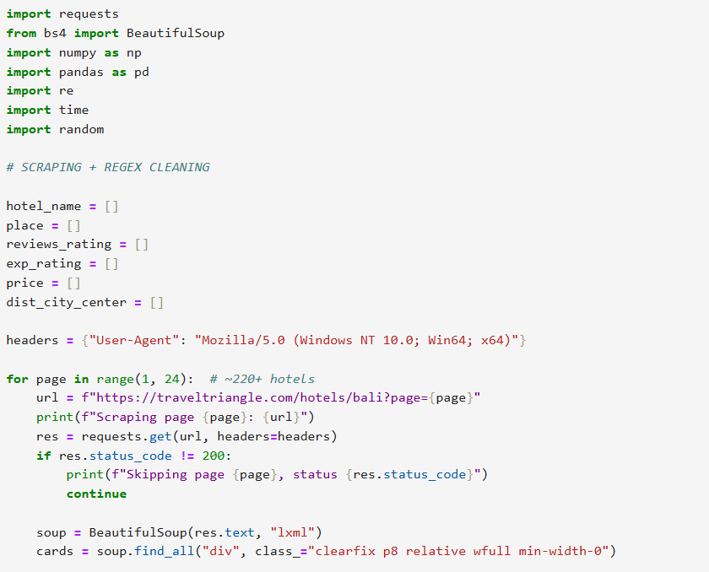
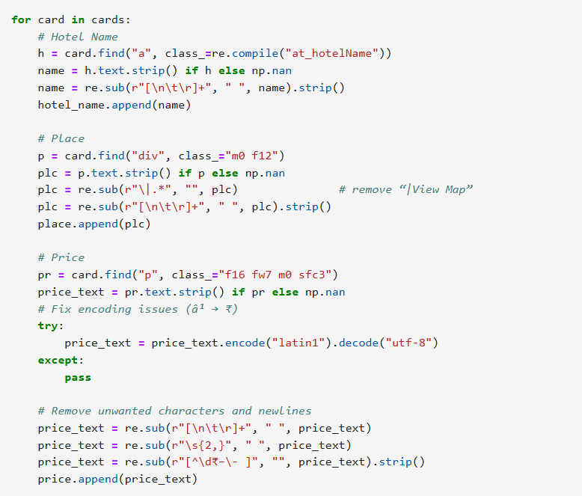
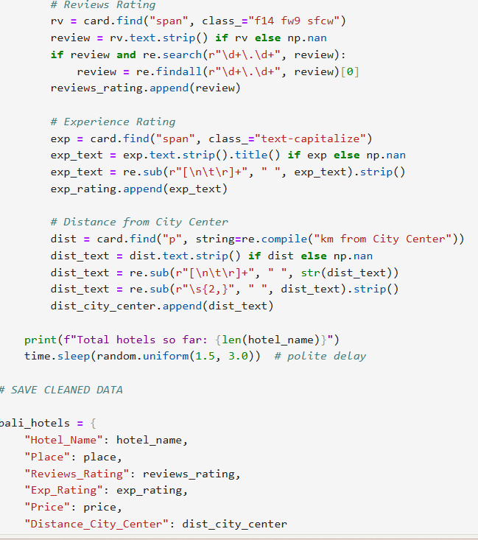
web scraping for data:

Slide 6
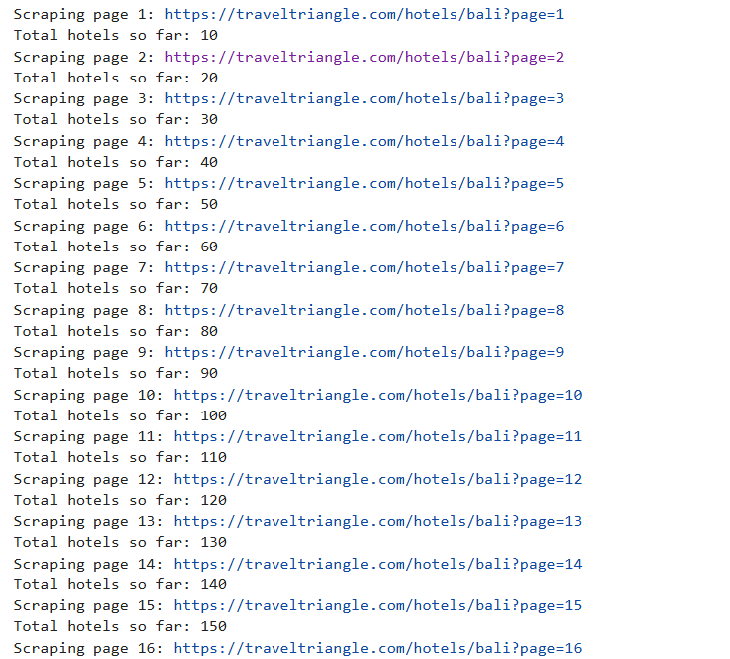
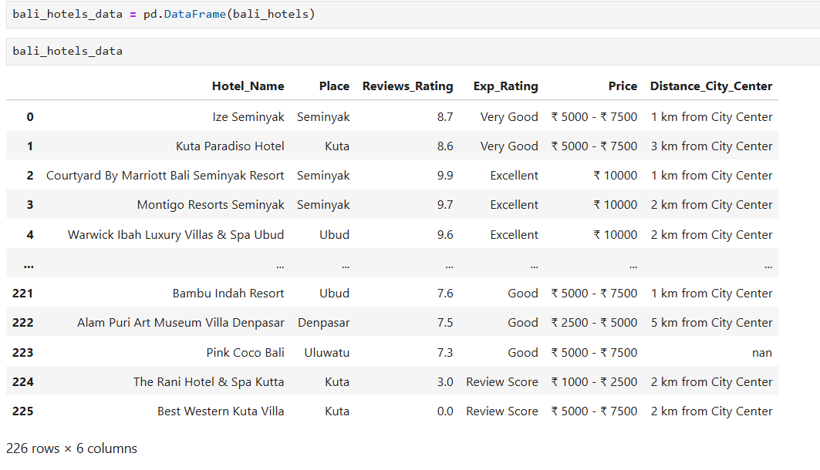
Extracting data:
DATASET:

Slide 7
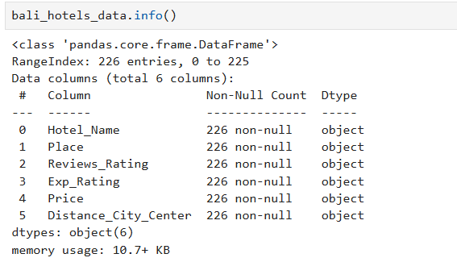
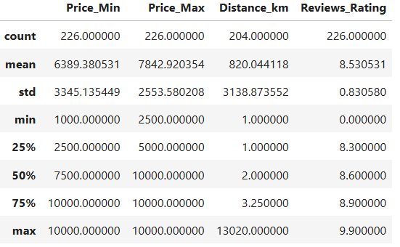
DATA SUMMARY :

Slide 8
Data Cleaning:
Handled Missing Values – Filled or removed null values in columns such as price, rating, and reviews to ensure completeness.
Removed Duplicates – Identified and deleted repeated hotel entries to maintain accurate and unique records.
Standardized Text Data – Cleaned and formatted hotel names, locations, and categories (fixed casing, removed extra spaces).
Converted Data Types – Transformed price data into numeric format and ensured ratings/reviews were in proper types.
Dropped Irrelevant Columns – Removed unnecessary fields that were not required for analysis.
Ensured Consistency – Standardized currency formats, corrected special characters, and aligned all values for reliable EDA.

Slide 9
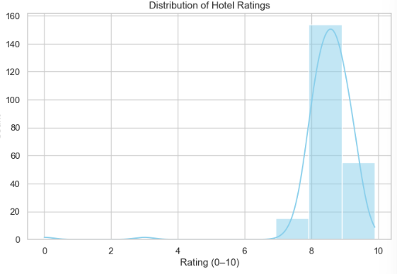
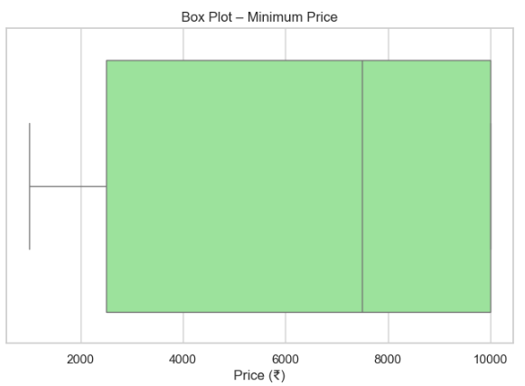
Univariate Analysis

Slide 10
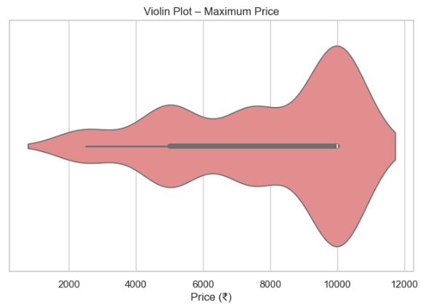
Univariate Analysis for Numerical Columns
• Variables: Maximum Price
• Plots Used: Violin Plot
• Insights:
• The distribution shows a wide spread of hotel prices, with many values concentrated between ₹4,000 and ₹8,000, indicating the common mid-range pricing trend in Bali hotels.
• The upper section of the violin plot is noticeably wider, showing that a significant number of hotels offer prices in the premium range (₹9,000–₹11,000).
• The presence of a long tail on the lower side indicates that while budget hotels exist, they represent a smaller portion of the dataset.
• Overall, the plot highlights high price variability, suggesting Bali caters to both mid-range travelers and luxury-seeking tourists.

Slide 11
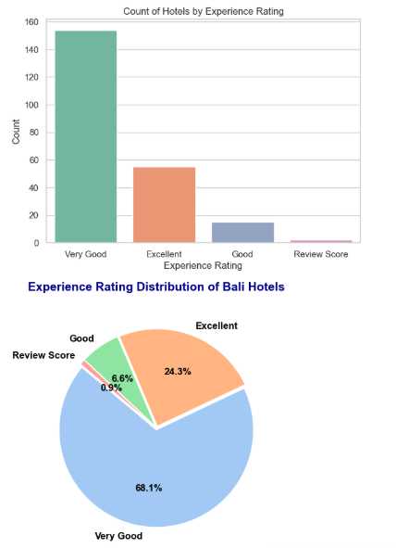
Univariate Analysis for Categorical Columns
• Variables: Experience Rating
• Plots Used: Bar Chart & Pie Chart
• Insights:
• The bar chart shows that “Very Good” is the most common experience rating among Bali hotels, representing the majority of listings in the dataset.
• The pie chart highlights that 68.1% of hotels fall under the Very Good category, indicating strong overall guest satisfaction across Bali.
• Around 24.3% of hotels received an Excellent rating, showing that a significant number of properties deliver premium-quality experiences.
• Only 6.6% of hotels are rated as Good, while *Review Score (0.9%) hotels are minimal, confirming that poorly rated hotels are rare in Bali.
• Overall, the rating distribution suggests that Bali maintains a high standard of hospitality, with most hotels offering positive guest experiences.

Slide 12
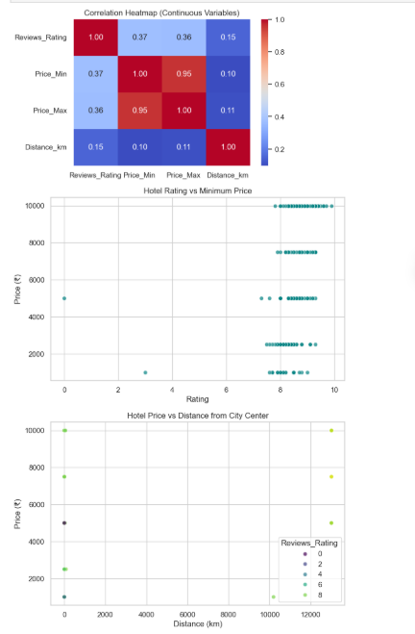
Bivariate Analysis (Continuous vs Continuous)
• Variables: Rating, Minimum Price, Distance from City Center
• Plots Used: Correlation Heatmap, Scatter Plots
• Insights:
• The correlation heatmap shows a moderate positive relationship between Rating and Price_Min (0.37), indicating that higher-rated hotels generally tend to have slightly higher minimum prices.
• A strong positive correlation (0.95) exists between Minimum Price and Maximum Price, confirming that hotels priced high at the lower end remain high at the upper end as well.
• The scatter plot of Rating vs Minimum Price shows that most hotels with ratings between 8 and 10 fall in the ₹2,000–₹6,000 range, suggesting that good-quality hotels are widely available at mid-range prices.
• The scatter plot of Price vs Distance (km) indicates very weak correlation, meaning hotel prices in Bali do not depend strongly on distance from the city center. Expensive and budget hotels are found at varying distances.
• Overall, the analysis shows that while hotel ratings and prices have some relationship, distance does not significantly influence pricing, making Bali’s hotel market diverse across regions.

Slide 13
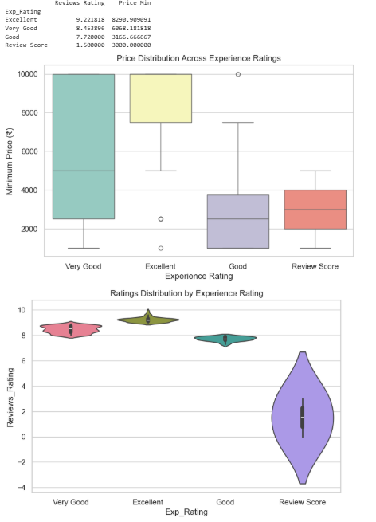
Bivariate Analysis (Continuous vs Categorical)
• Variables: Experience Rating, Minimum Price, Customer Rating
• Plots Used: Box Plot & Violin Plot
• Insights:
• The box plot shows that hotels rated “Very Good” and “Excellent” have the highest minimum prices, indicating these categories attract more premium-priced properties.
• Hotels with a “Good” rating show lower and more varied price ranges, suggesting budget-friendly options dominate this segment.
• Hotels under “Review Score” have the lowest minimum prices, showing they typically belong to the budget category with limited service quality.
• The violin plot displays that customer ratings remain consistently high for Very Good and Excellent categories, centered around score ranges of 8 to 9.5.
• However, the Review Score category shows a much wider spread and lower overall ratings, indicating significant inconsistency in guest experiences.
• Overall, the analysis suggests that higher experience ratings are strongly associated with higher minimum prices and more stable customer satisfaction.

Slide 14
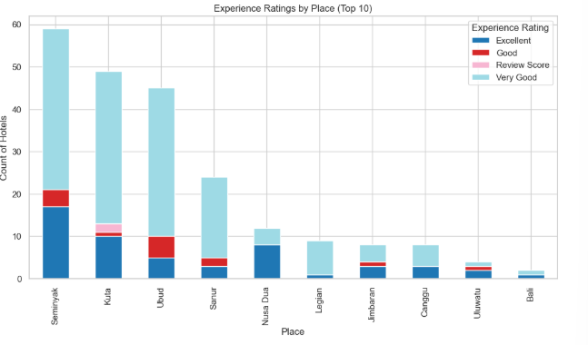
Bivariate Analysis (Categorical vs Categorical)
• Variables: Place (Top 10), Experience Rating
• Plots Used: Stacked Bar Chart
• Insights:
• Seminyak, Kuta, and Ubud have the highest concentration of hotels, with Seminyak leading the list, indicating these are the most popular tourist zones in Bali.
• Across all top locations, “Very Good” hotels dominate, showing that most hotels consistently deliver high-quality experiences regardless of the area.
• Excellent-rated hotels are mostly found in Seminyak, Kuta, and Ubud, highlighting these regions as premium hospitality hubs.
• Locations like Canggu, Jimbaran, and Uluwatu have fewer hotels overall but maintain a strong proportion of Very Good ratings, showing reliable service quality despite smaller volume.
• Review Score hotels appear in very small numbers across all places, confirming that poorly rated hotels are rare in the top tourist regions.
• Overall, the chart indicates that Bali’s major tourist spots not only have more hotels but also maintain consistently strong guest experience ratings, making them highly competitive hospitality markets.

Slide 15
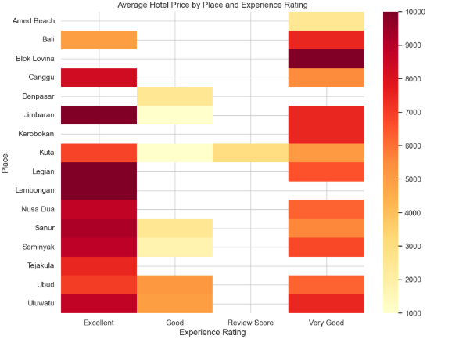
Multivariate Analysis
• Variables: Place, Experience Rating, Average Price
• Plots Used: Heatmap (Price vs Rating vs Location)
• Insights:
• The heatmap shows that premium tourist areas like Nusa Dua, Seminyak, Jimbaran, and Ubud have the highest hotel prices across all experience rating categories.
• Locations such as Canggu, Denpasar, Kerobokan, and Sanur show moderate pricing, suggesting they cater to both mid-range and premium travelers.
• Excellent-rated hotels in Nusa Dua, Seminyak, and Ubud consistently show very high average prices, reflecting their reputation for luxury stays.
• Very Good–rated hotels display a wider price range across different locations, indicating that this category includes both affordable and high-end properties.
• Places like Amed Beach, Bali, and Tejakula are more budget-friendly, appearing lighter on the heatmap, especially in the “Good” and “Very Good” categories.
• Review Score hotels show low representation and much lower prices across all locations, confirming their position in the budget segment.
• Overall, the heatmap emphasizes that hotel pricing in Bali strongly depends on both location and experience rating, with certain areas consistently commanding premium pricing.

Slide 16
Key Insights:
Bali’s most popular hotel regions like Seminyak, Kuta, and Ubud have the highest number of hotels.
Very Good is the most common rating, showing consistently high service standards across Bali.
Higher-rated hotels tend to have higher minimum prices, especially in premium locations.
Price variation is influenced more by location and experience rating than by distance from the city center.
Budget hotels are available but form a very small proportion of the total listings.
Premium tourist spots like Nusa Dua, Jimbaran, and Seminyak consistently show higher prices across rating categories.

Slide 17
Challenges:
Inconsistent formatting in hotel names, locations, and categories caused difficulty in standardizing text data.
Missing or incomplete values in price, rating, and reviews required additional cleaning steps.
Duplicate hotel entries across pages made it challenging to maintain dataset accuracy.
Different currency formats and symbols made converting prices into numeric values difficult.
Dynamic website structure occasionally interrupted the scraping process and caused extraction errors.
Large variation in hotel prices across regions made detecting outliers more complex.

Slide 18
Learnings (from your project experience)
Learned how to perform web scraping using BeautifulSoup and Requests.
Understood how to handle missing data, duplicates, and inconsistent formatting in real-world datasets.
Improved skills in exploratory data analysis (EDA) and identifying patterns in visualizations.
Learned to use heatmaps, violin plots, boxplots, and scatter plots to extract meaningful insights.
Gained experience in cleaning numerical and categorical data to prepare it for analysis.
Strengthened understanding of how pricing, ratings, and location affect hotel performance.

Slide 19
conclusion:
The Exploratory Data Analysis (EDA) of Bali hotels shows that Bali’s hospitality industry delivers consistent quality across all hotel segments.
Most hotels maintain high ratings regardless of price, and the market is dominated by mid-range hotels offering affordable luxury.
Price is more influenced by location than by customer satisfaction — hotels in Seminyak and Ubud are premium, while Kuta and Legian provide budget-friendly excellence.
Overall, Bali’s hotel industry is competitive, customer-focused, and maintains a high global standard.

Slide 20

THANK YOU

